Slide 1

AGE PREDICATION USING MRI BRAIN SCAN
Dr. Babasaheb Ambedkar Technological University,
Lonere-402103,
DEPARTMENT OF INFORMATION TECHNOLOGY
Guided by:
Prof. S.S.Barphe
Prof. S.R.Hivre
Submitted by:
Sainath D. Rudrurkar(20150751)
Shivam D. Bobde(20160772)
Atish R. Bagate(20150702)
Trupti U. Bandgar(20150703)
Sana Fakir(20160774)

Slide 2
INTRODUCTION:
Through analysis of structural magnetic resonance imaging (MRI) images, classification and prediction of the age of adults were implemented to make analysis of the age-related.
Due to the distributed nature of the aging spatial pattern in human brain, a multivariate voxel selection method based on sparse representation was introduced to identify the most discriminative brain regions.
It can effectively pick out the isolating voxels as well as the clustered voxels which contribute enormously to the classification and age prediction.
Difference trend of the brain development between the senior and the junior was observed.
Four different models were used to fit the predicted age of all subjects in space.

Slide 3
PROBLEM STATEMENT:
In this project we apply regression techniques to predict a person's age from a three-dimensional magnetic resonance image(MRI) of their brain.
Magnetic Resonance Imaging (MRI) is a key technology in medical imaging as it provides a tool to investigate sensitive organs such as the brain.
MRI typically operates on a medium length scale which corresponds to a resolution of about 1mm³.
We will learn how to deal with real medical image data, and how to process it to apply machine learning techniques successfully.
In this project we start with a more modest goal and try to predict the age of a person from their brain MR image.

Slide 4
PREREQUISITES:
Python 3.3+
Tensorflow
SciPy
Nibabel
(Optional) IXI-MRI : Large-scale MRA Dataset

Slide 5
HARDWARE REQUIREMENT:
CPU: Core 2 Duo/Athlon X2 or better
RAM: 8GB
Video Card: NVIDIA 1080PX or GTX Series, AMD Radeon 1800 Series or better.
Graphic Card: 2MB of Graphics Memory.
Storage: 1TB.

Slide 6
PROJECT DISCRIPTION:
The training set provided as numpy array with shape. The rows run over samples, the columns over features. Basically, each feature is a different voxel (3D pixel) of the image. You can get the 3D structure back with numpy.
The test set provided in the same format as the training set, but with shape.
The targets for the regressions training. The k-th row contains the age of the k-th sample in training data.
Finally a sample submission file in the correct format.

Slide 7
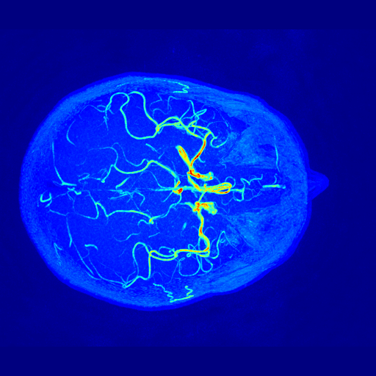
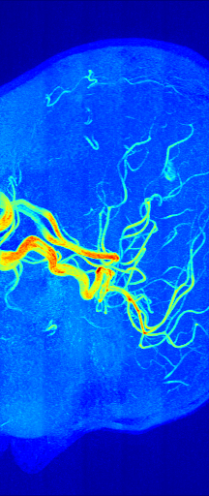
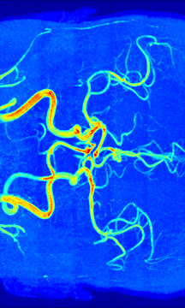
BRAIN IMAGES:
BRAIN X-AXIS
BRAIN Y-AXIS
BRAIN Z-AXIS

Slide 8
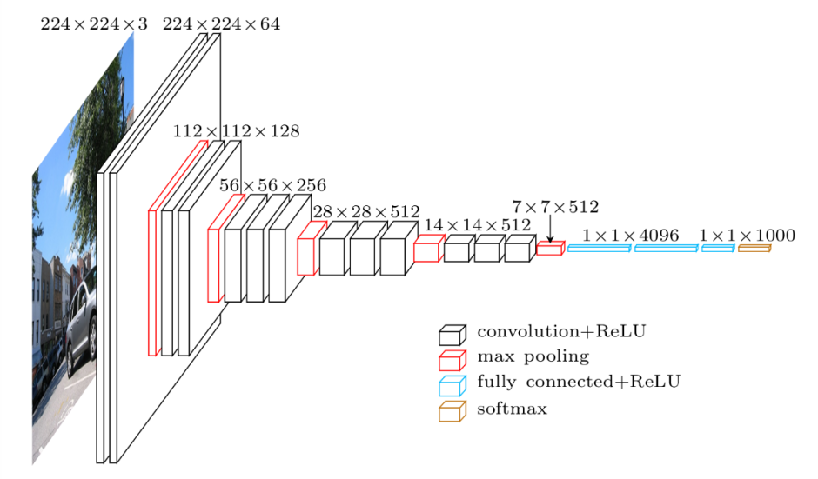
IMAGE PROCESSING:

Slide 9
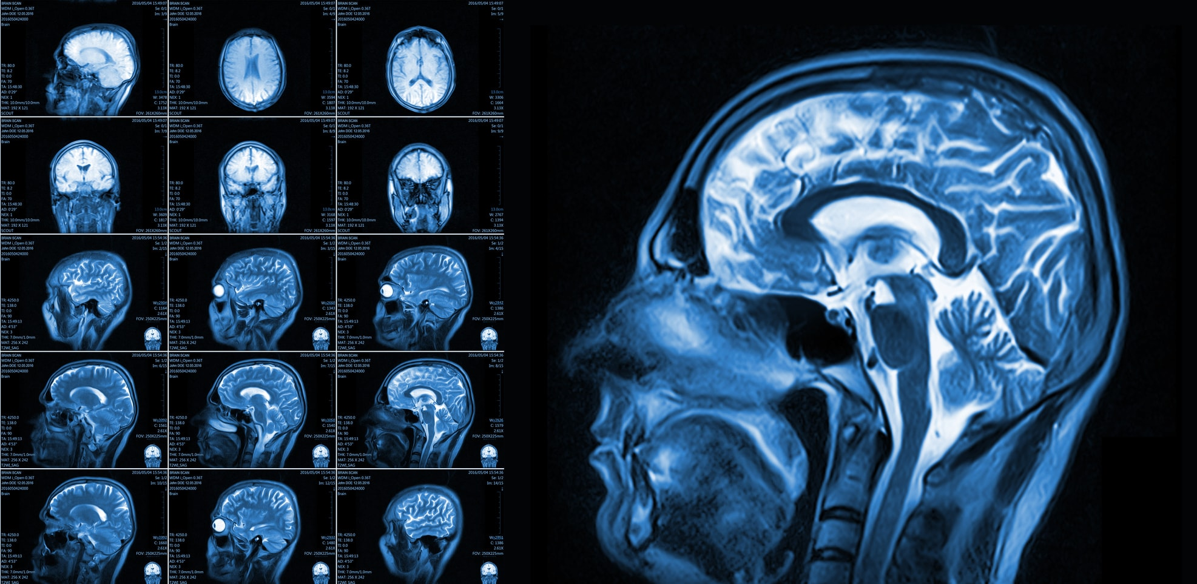
MRI IMAGE DATA:

Slide 10
APPLICATION:
Prediction of age will help to doctor for better medical prescription. Doctor will give different medicines as per as patients age predicted by brain scan.
Brain scan will help the high tech head scan essential for early detection that could save patients life.
Brain scan helps to detect brain problems like Stroke, brain damages, Cysts and tumours, etc.
It will help for dead body investigation, that will show age.

Slide 11
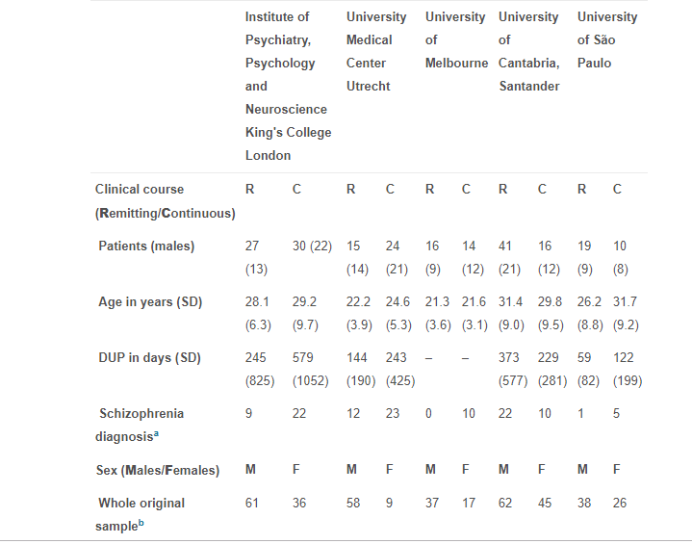
DATA-SET VIEW:

Slide 12
REFERENCES:
https://www.sciencedirect.com/science/article/pii/S105381191630146X.
https://github.com/j52y/mri-age-classifier
https://www.kaggle.com/c/ml-project-1/data.
https://www.kaggle.com/c/ml-project-1/data.
https://www.sciencedirect.com/science/article/pii/S1053811916303342.
https://www.mendeley.com/research-papers/agerelated-classification-prediction-based-mri-sparse-representation-method/

